Slide 1
Alvor, Portugal
By Imtiyaz Baig Moghal

Slide 2

Alvor, Portugal
Alvor is a small fishing village in the south of Portugal.
It is a very popular holiday destination.
Notes:
Hello this is descriptionHello this is description
Hello this is description
Hello this is description
Hello this is description
Hello this is description
Hello this is description
Hello this is description
Hello this is description

Slide 3
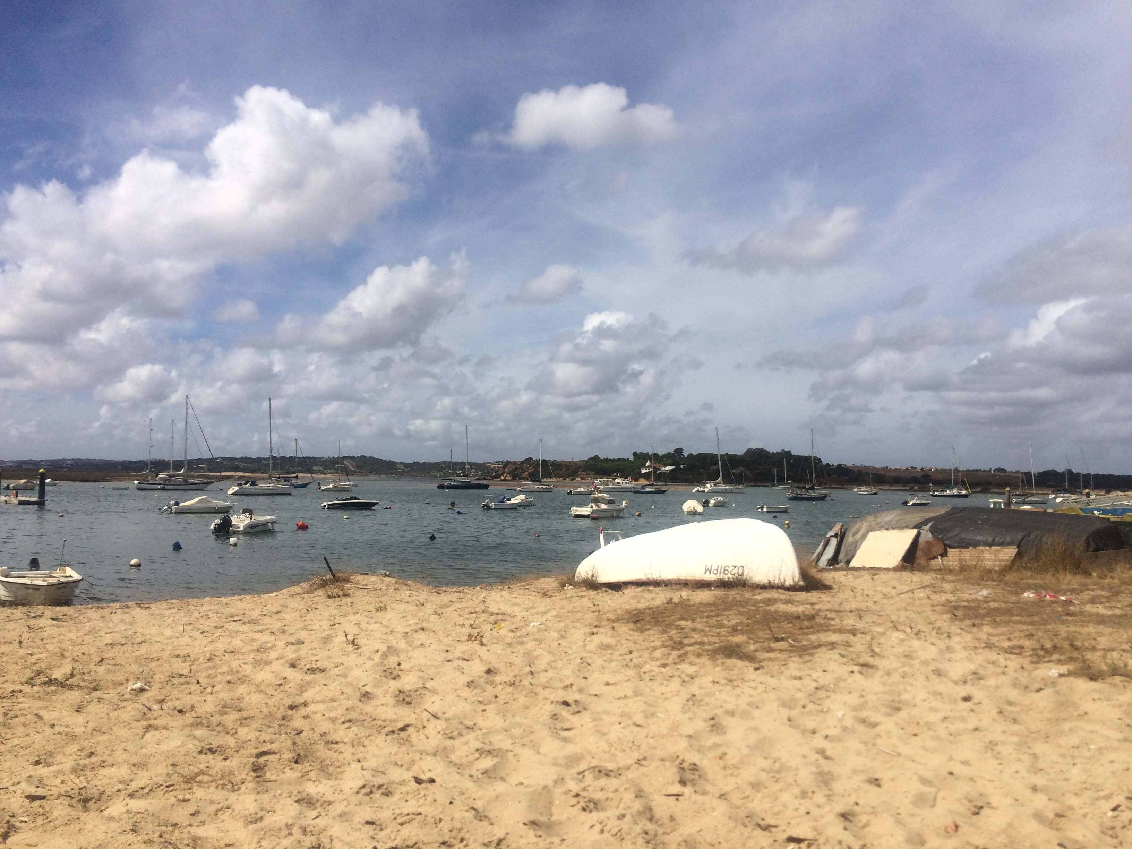
Key Points
The Beach – 3.5km
Pathways- Elevated pathways
Fishing trips
Bars and Clubs

Slide 4
Mixed text types
The quick brown fox jumps over the lazy dog. The quick brown fox jumps over the lazy dog. The quick brown fox jumps over the lazy dog. The quick brown fox jumps over the lazy dog. The quick brown fox jumps over the lazy dog.
Family Focused
Sandy Beach
Waves

Slide 5
Alvor Pictures

Slide 6
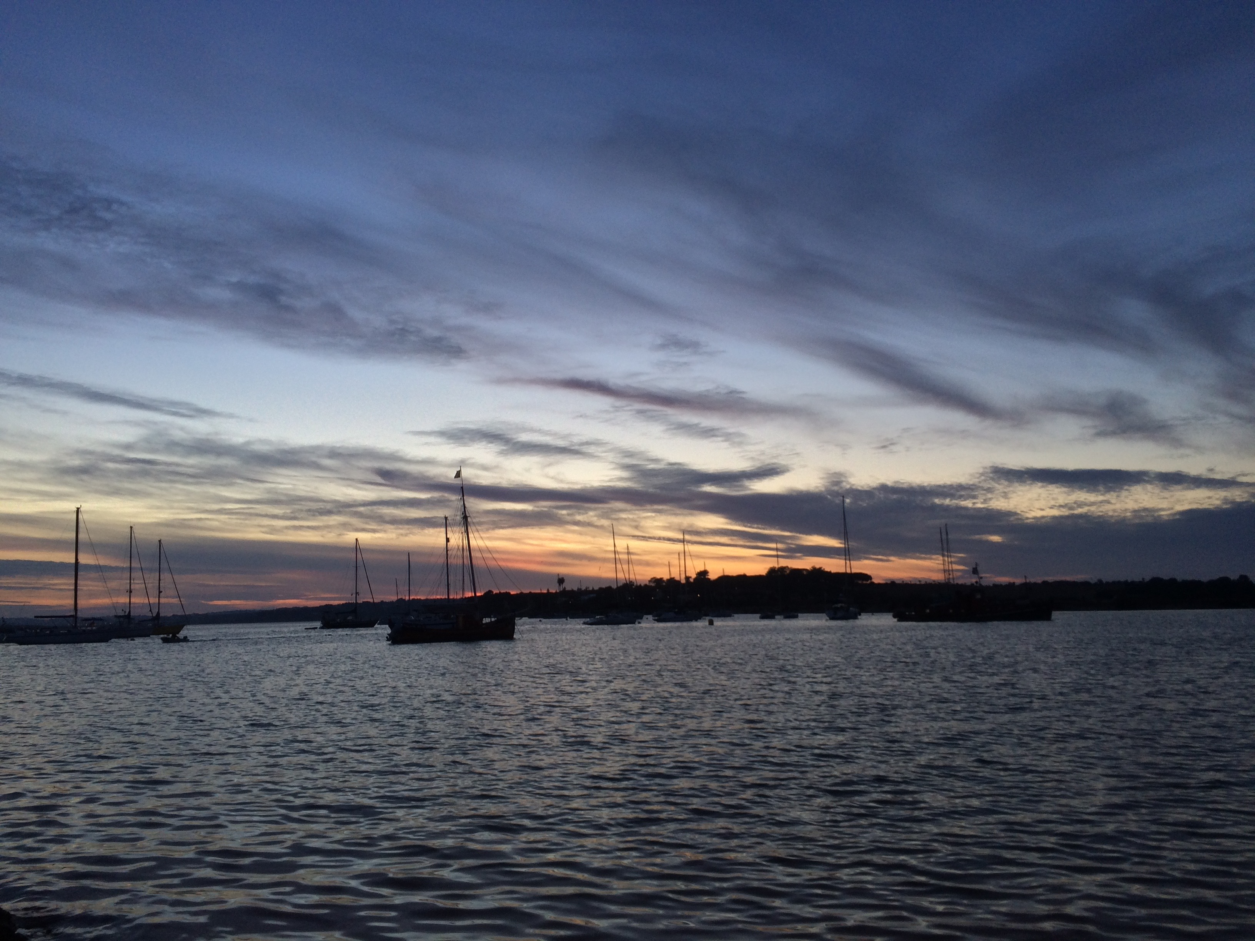
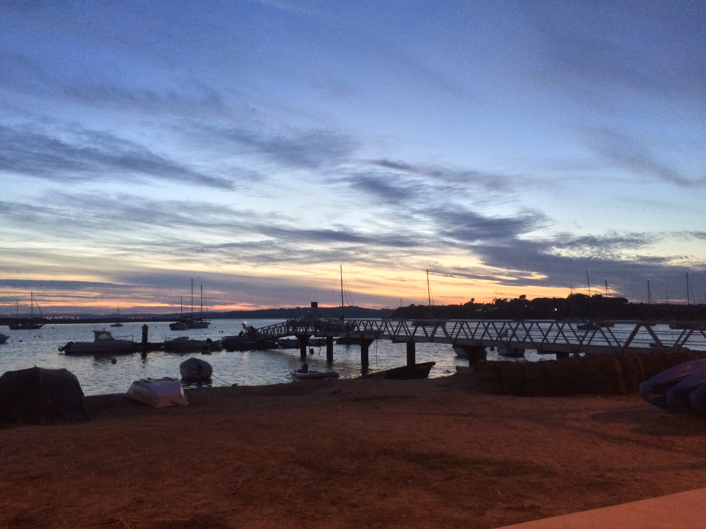
Alvor Pictures

Slide 7
Alvor Temperature
 | Apr | May | June | July | August
2018 | 19º | 22º | 24º | 25º | 26º
2017 | 20º | 21º | 24º | 24º | 25º
2016 | 16º | 19º | 23º | 25º | 26º

Slide 8
Temp Chart

